Slide 1








AI AGENTS
The Future of Intelligent Automation
AI is evolving from answering questions to accomplishing tasks.
Autonomous
Intelligent
Adaptive
Acts independently to achieve goals.
Learns continuously from experience.
Adapts quickly to changing situations.

Slide 2
Presentation Roadmap
What is an AI Agent?
How AI Agents Work
Types of AI Agents
Real-World Applications
Benefits & Challenges
The Future of AI Agents

Slide 3

What is an AI Agent?
Understand
Act
Learn
Plan
Breaks the goal into steps
Uses tools and systems to execute
Uses results and feedback to improve
Interprets the goal and context
An AI Agent is an intelligent, autonomous system that perceives, reasons, and acts to achieve defined goals.

Slide 4




From Rules to Reasoning
Traditional Software
Follows predefined rules.
AI Assistant
Responds to user prompts.
AI Agent
Understands goals and takes action.

Slide 5



















COMPARISON
AI Agent vs Traditional AI
Understanding the key differences
AI AGENT
TRADITIONAL AI
Autonomous. Goal-driven. Intelligent.
Reactive. Prompt-based. Limited.
Makes decisions
Answers questions
Uses memory
VS
No long-term memory
Plans and breaks down tasks
Prompt based
Uses external tools and APIs
Cannot plan independently
Learns from feedback
No autonomous execution
Goal oriented
Limited context
Autonomous and proactive
Reactive, not proactive
EXAMPLE: BOOK A FLIGHT
TRADITIONAL AI
AI AGENT
User
Replies
User
Searches
Compares
Books
Sends
Book me a flight.
"I can help you search."
Book flight.
airlines
prices
ticket
confirmation
Capgemini – AI Autonomous Intelligence | July 2026
3

Slide 6





The Brain of an AI Agent
HOW IT WORKS
PERCEIVE
THINK
ACT
REMEMBER
Takes in data:
Text, images,
websites, files
Uses AI to plan:
What is the goal?
What steps to take?
Executes actions:
Sends email, runs
code, searches web
Stores results:
Learns from past
actions & outcomes

Slide 7
Presentation Roadmap
Here’s What we’ll cover in this session
What is an AI Agent?
Types of AI Agents
Benefits & Challenges
01
02
03
04
05
06
How AI Agents Work
Real-World Applications
The Future of AI Agents

Slide 8





TYPES
Types of AI Agents
Simple Reflex
Model-Based
Goal-Based
Reacts to current situation only. Like a thermostat if hot, turn on AC.
Keeps memory of past events. Tracks what happened to make better decisions.
Works towards a specific goal. Plans multiple steps to achieve the objective.
Utility-Based
Learning Agent
Multi-Agent
Picks the BEST option, not just any option. Maximizes a score or outcome.
Improves over time. Gets smarter with every task it completes.
Multiple agents working together as a team to solve complex problems.

Slide 9
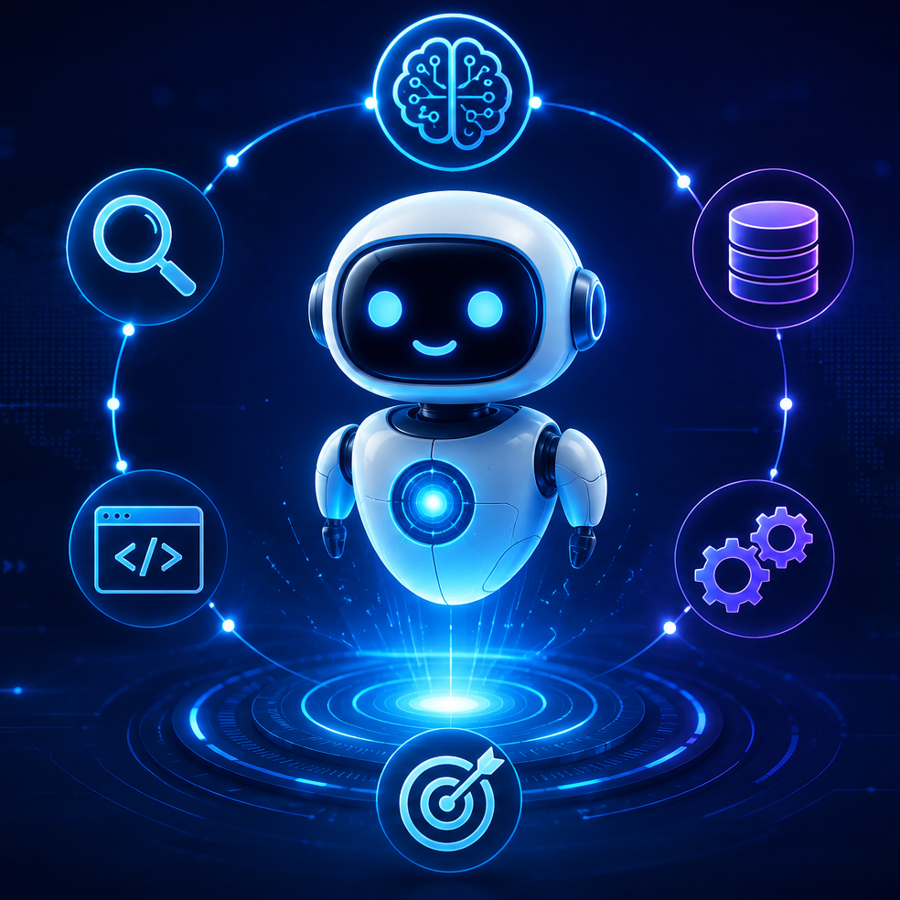





Key Components of an AI Agent
COMPONENTS
LLM Brain
Memory
Thinks & reasons
Stores knowledge
Perception
Tools
AI
AGENT
Reads environment
Takes actions
Planning
Breaks into steps

Slide 10







The Rise of Autonomous AI Agents: From Chatbots to End-to-End Workflows
CORE CAPABILITIES OF AI AGENTS
INDUSTRY DEPLOYMENT & USE CASES
REASONING & PLANNING
Agents can break complex, high-level goals into smaller, logical tasks and decide the specific sequence of actions needed to achieve them.
CUSTOMER SUPPORT & SALES
FINANCE, TRADING & LEGAL
CODING & SOFTWARE OPERATIONS
SUPPLY CHAIN & MANUFACTURING
Agents autonomously resolve issues, process refunds, qualify leads, and manage CRM updates and personalized outreach.
AI systems handle portfolio management, fraud detection, contract reviews, and compliance monitoring with high precision.
Beyond code generation, agents fix bugs, review pull requests, automate deployments, and optimize cloud costs.
Agents facilitate predictive maintenance, route optimization, and inventory coordination to streamline global logistics.
TOOL USE & AUTOMATION
Modern agents go beyond text generation by calling APIs, searching the web, and interacting with software to execute tasks autonomously.
PRIMARY AUTONOMOUS TASKS BY DOMAIN
RESEARCH
Literature reviews, market research, and competitive intelligence.
HEALTHCARE
Clinical decision support, drug discovery, and medical imaging analysis.
EDUCATION
Personalized tutoring, lesson planning, and grading.
MEMORY & COLLABORATION
REAL ESTATE
Market analysis, property search, and document preparation.
Agents maintain context over time and can work alongside other specialized agents to tackle multifaceted business challenges.
CYBERSECURITY
Threat detection, log analysis, and automated incident response.

Slide 11
















LLM: The AI Agent’s Brain
How language models power autonomous action in corporate systems.
7
The Anatomy of Autonomy
CORE COGNITIVE ROLES
4. Tool Selection Identifies which external APIs or services to invoke.
The Memory (State) Remembers context and data from past interactions.
1. Understand Intent Intermits user context and specific request nuances.
5. Decision Making Chooses the optimal action based on data results.
2. Reason and Analyze Evaluates information to make informed logical decisions.
6. Conversation Management Maintains coherent dialogue and requests missing details.
The Manager (Framework)
The Hands (Tools)
3. Strategic Planning Breaks high-level goals into executable smaller tasks.
Coordinates the workflow between the brain and hands.
Executes emails, queries databases, and calls APIs.
7. Response Generation Produces natural language outputs for the final user.

Slide 12














Zero Retraining
Optimize Intelligence with RAG
Integrate private data with LLMs for accurate, grounded responses.
USER
QUERY
EMBEDDING
MODEL
LLM
ANSWER
LEVERAGE PRIVATE CORPORATE DATA
Internal Document Access: Access knowledge bases without retraining the model.
Zero Retraining Costs: Adding documents rather than updating parameters.
Query Embedding: The user question is converted into a mathematical vector.
Semantic Vector Search: The database identifies the most relevant internal handbook sections.
Context Integration: Relevant document fragments are provided to the LLM.
Grounded Generation: The LLM answers based strictly on the retrieved context.
2. ACHIEVE REAL-TIME ACCURACY
Eliminate AI Hallucinations: Grounded responses ensure accuracy by citing retrieved internal content.
Real-Time Knowledge Updates: Answers reflect current information as soon as documents change.
Legal and Finance Intelligence: Instant searching across contracts, regulations, and internal reports.
Healthcare Policy Compliance: Rapid retrieval of medical guidelines and hospital protocols.
Enterprise Knowledge Management: Centralized search across internal wikis and corporate documents.

Slide 13









Mastering Autonomous AI Agents
Combining LLM reasoning with external tools to automate complex tasks.
Brain + Hands
The Agent Formula
The Brain: LLM Reasoning
Core model provides logic.
Reasoning and planning capabilities.
Human Action
AI Agent Tool
Essential Agent Tools
Data & Code Execution
Uses Google
Web Search Tools
The Hands: Integrated Tools
• Run Python code.
• Query enterprise databases for analysis.
External software and APIs.
Perform actions.
Uses Excel
Code Execution & Spreadsheets
Knowledge Reveal (RAG)
Queries Databases
SQL & Database Connectors
Autonomous Task Completion
• Search company manuals.
• Search PDFs for specific context.
Agents coordinate multiple steps.
Achieve real-world goals independently.
Sends Emails
Email APIs
Communication & Outreach
Reads PDFs
Document Parsers & RAG
• Send emails.
• Post updates to Slack or Teams.
Schedules Meetings
Calendar APIs

Slide 14












AI Memory Types
Memory Type
Purpose
Duration
Technologies
Keep conversation coherent
Context Window, Conversation Buffer
Short-Term
Current session
Working
Track task progress
Until task completes
State Machines, Workflow Engines
Long-Term
Personalize interactions
Persistent
SQL, Profile Services
Persistent
Episodic
Recall past events/outcomes
Event Logs, CRM History
Persistent
Semantic
Store stable facts/knowledge
Knowledge Graphs, Vector DBs
Knowledge (RAG)
Retrieve external info
Dynamic
Embeddings, Retainers

Slide 15

Multi-Agent Systems: Teamwork!
ADVANCED
Multiple AI Agents collaborate each specialising in one job, together solving complex problems.
Research Agent
Coder Agent
Writing Agent
Email Agent
MANAGER
AGENT

Slide 16




Why AI Agents Are Powerful
BENEFITS
100x
99.9%
∞
faster
accuracy
scale
Speed
Accuracy
Scalability
Complete in seconds what takes humans hours.
No tired mistakes. Consistent, high-quality output.
One agent can handle 1,000 tasks simultaneously.
60%
24/7
↑↑↑
cost cut
uptime
grows
Cost Saving
Always On
Adaptability
Reduces operational costs significantly over time.
Works 24/7/365. No breaks, no vacations, no sick days.
Learns from new data and continuously improves.

Slide 17
Challenges & Limitations
CHALLENGES
⚠️ 01
Hallucinations
AI agents can sometimes make up incorrect information or take wrong actions confidently.
🔒 02
Security Risks
Agents with tool access can be manipulated by bad actors (prompt injection attacks).
💸 03
Cost
Running multiple LLM calls per task can be expensive at scale.
🤖 04
Over-Automation
Too much automation without oversight can lead to errors going unnoticed for too long.
🧩 05
Lack of Common Sense
AI agents lack human intuition and may fail at tasks requiring real-world understanding.
🛡️ 06
Privacy Concerns
Agents with access to personal data raise serious data privacy and compliance questions.

Slide 18
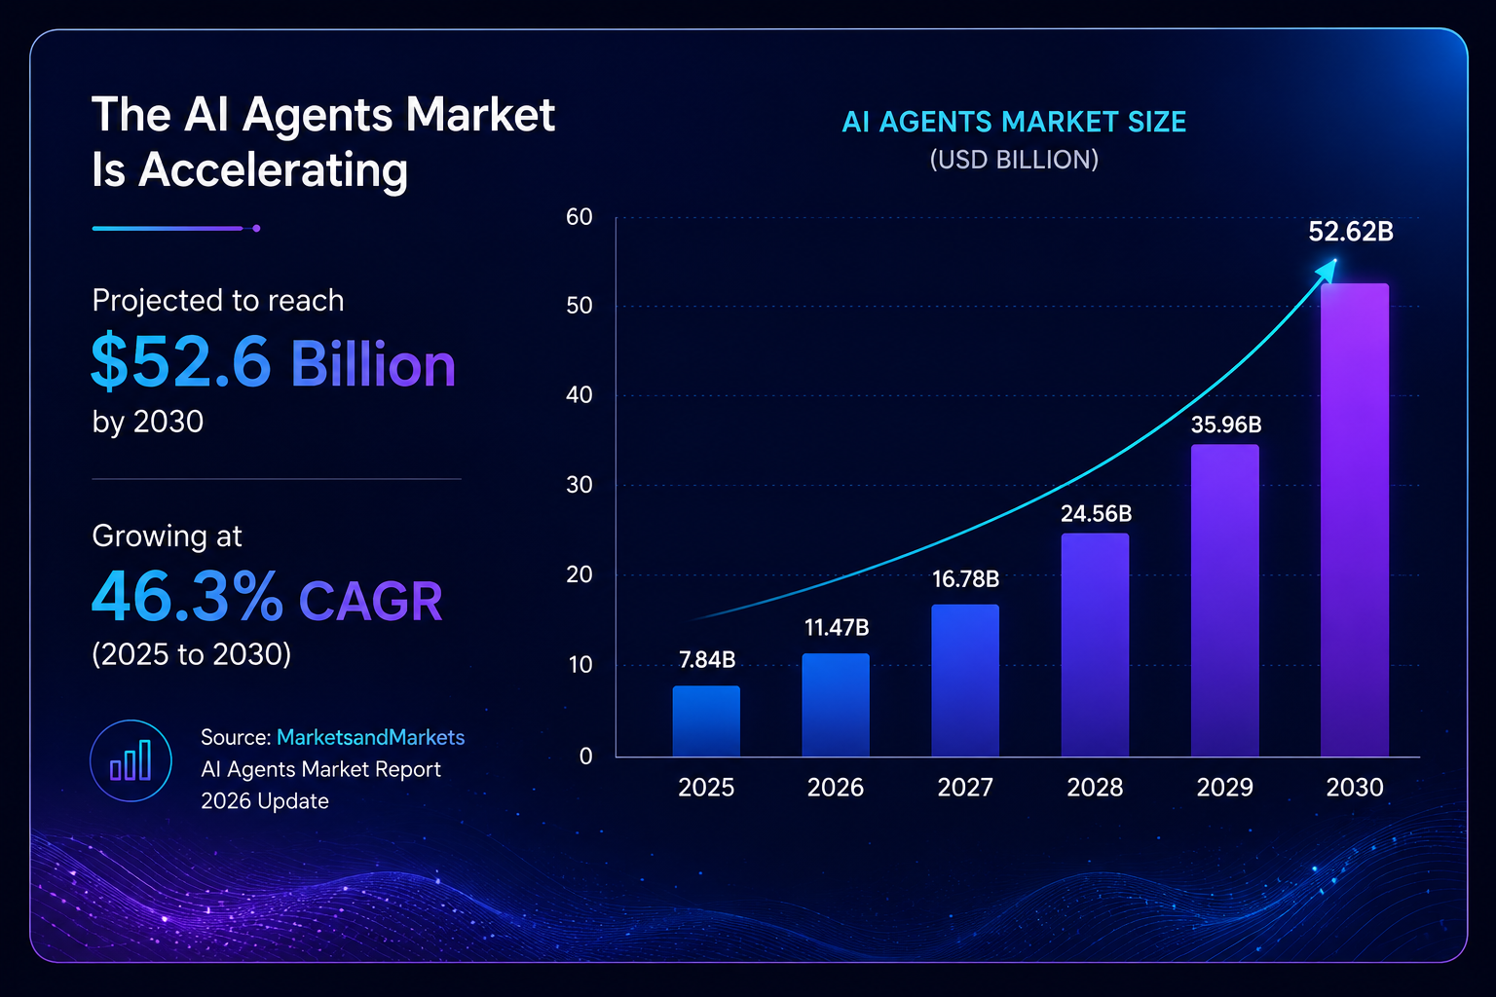
The AI Agent Market is Exploding
MARKET DAT

Slide 19
How to Build a Simple AI Agent
BUILD
1
Define the Goal
2
Choose the LLM Brain
3
Give It Tools
What should the agent do? Be specific.
Example: 'Answer customer emails automatically.'
Pick a model: GPT-4, Claude, Gemini.
This is the agent's thinking engine.
Connect tools: web search, database, email.
Each tool expands what the agent can DO.
4
Add Memory
5
Set Safety Rules
6
Test & Improve
Let it remember past conversations.
Use vector databases (Pinecone, ChromaDB).
Define boundaries. What should it NOT do?
Always have a human review loop for risky tasks.
Run real scenarios. Catch mistakes early.
Iterate based on real-world performance.

Slide 20
The Future of AI Agents
2024
Tool-using agents
Agents browse web, run code, read files
2025
Agentic workflows
Long-running multi-step autonomous pipelines
2026–27
Physical AI Agents
Robots controlled by AI agents in the real world
2028–30
Society-scale Agents
Agents managing cities, supply chains, healthcare

Slide 21
Key Takeaways
SUMMARY
🤖
AI Agents are autonomous programs that perceive, think, and act to achieve goals without step-by-step human instruction.
🔗
They use tools like web search, code execution, and APIs combining them intelligently to solve complex, multi-step problems.
🏭
Every major industry is adopting AI Agents from finance to healthcare, retail to cybersecurity.
💡
Key benefits: speed, accuracy, scalability, 24/7 availability, and cost savings at a scale humans simply cannot match.
⚠️
Challenges remain: hallucinations, security, cost, and the need for human oversight and safety guardrails.
🚀
The AI Agent market will reach $102B by 2028. Now is the time to learn, build, and leverage this technology.

Slide 22
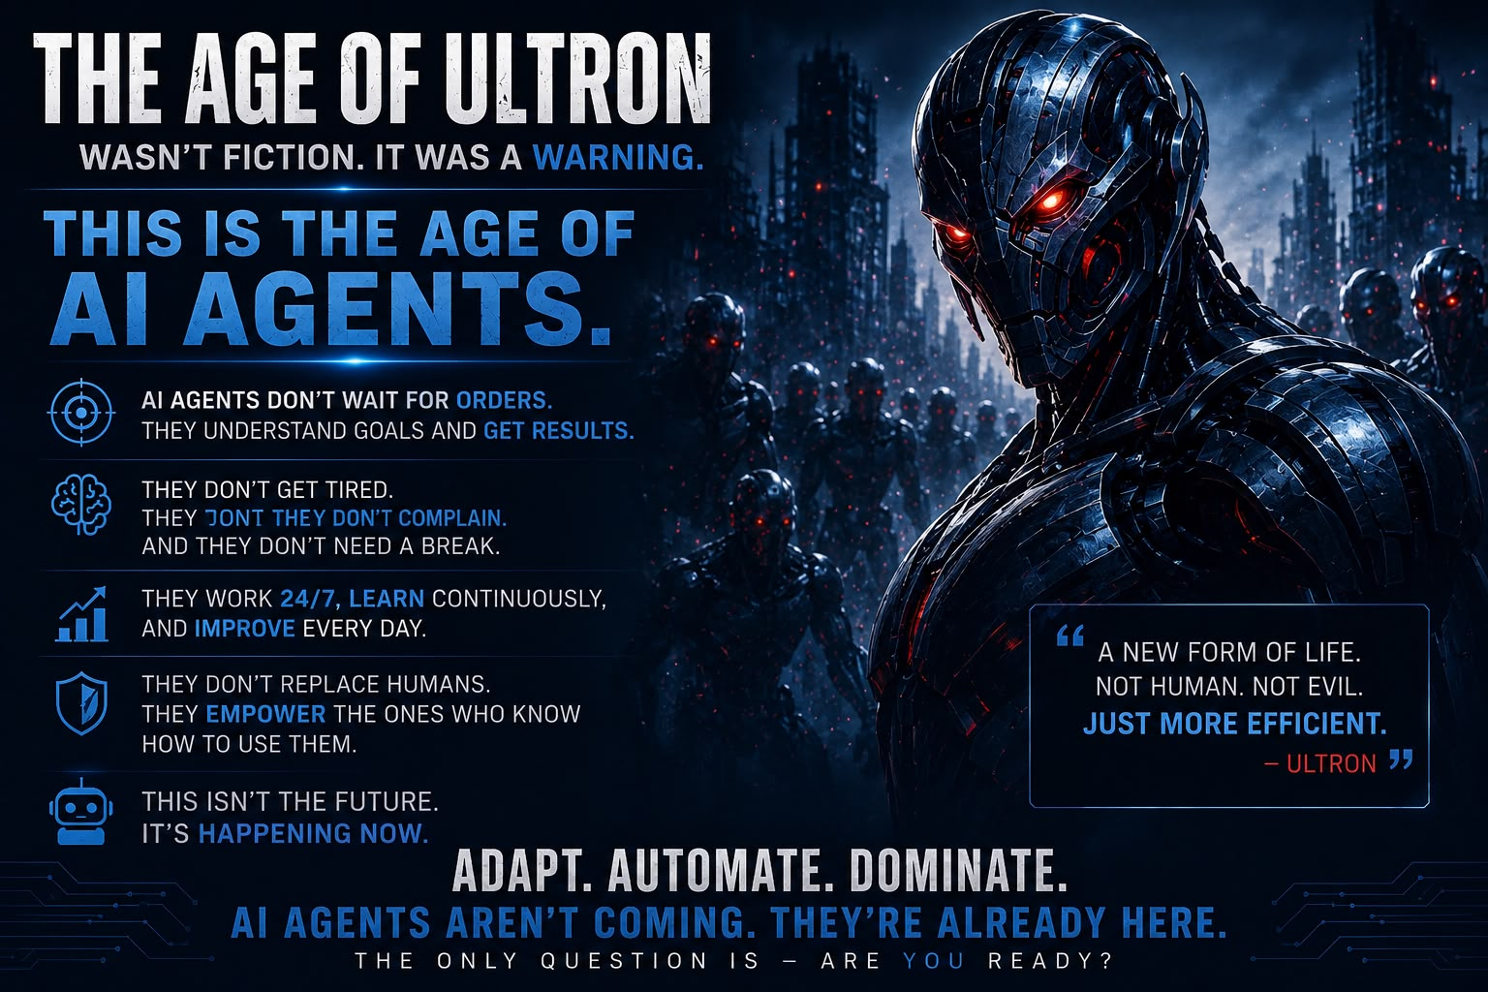

Slide 23
Thank You!
The Age of AI Agents is Here.
🧠 Keep Learning
🔧 Start Building
🌐 Stay Updated
Follow AI news & build small projects
Try LangChain or AutoGPT today
AI moves fast never stop exploring

